Slide 1
Trial Camera
UI Design
2024-01-02

Slide 2

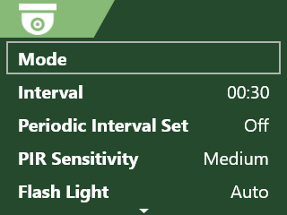
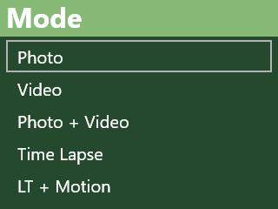
FUNCTION 1
Home Page
Big Icon to select
Subpage 1
Subpage 2

Slide 3

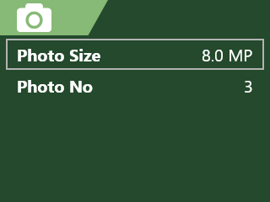
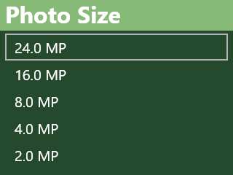
FUNCTION 2
Home Page
Big Icon to select
Subpage 1
Subpage 2

Slide 4

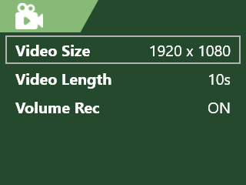
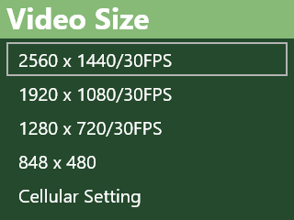
FUNCTION 3
Home Page
Big Icon to select
Subpage 1
Subpage 2

Slide 5

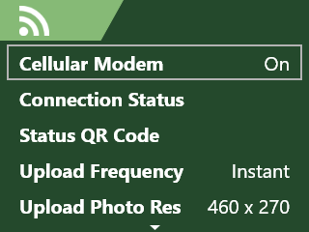
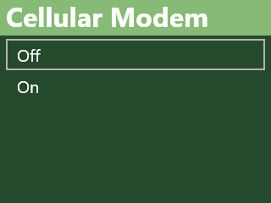
FUNCTION 4
Home Page
Big Icon to select
Subpage 1
Subpage 2

Slide 6

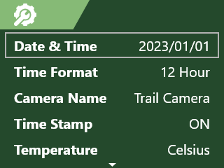
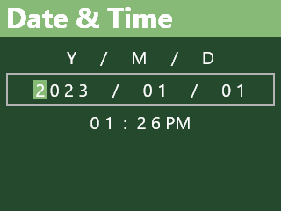
FUNCTION 5
Home Page
Big Icon to select
Subpage 1
Subpage 2

Slide 7
Thankyou
-To be continued…

